Slide 1
How To Simulate Standard Workload Traces on Kubernetes Cluster
Smita Vijayakumar
3rd Year PhD Student
Supervisor: Evangelia Kalyvianaki
Notes:
This talk is going to be focused on the engineering aspect on translating workload files into Kubernetes workload.

Slide 2
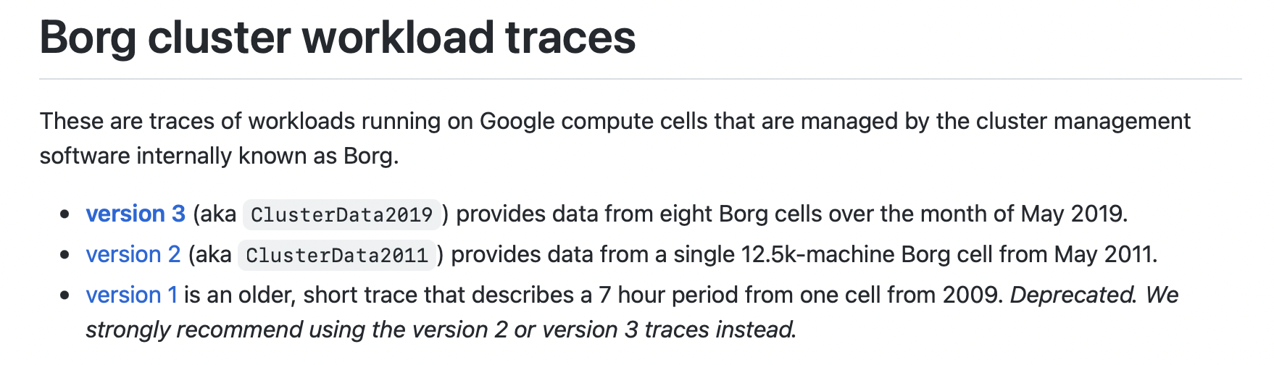
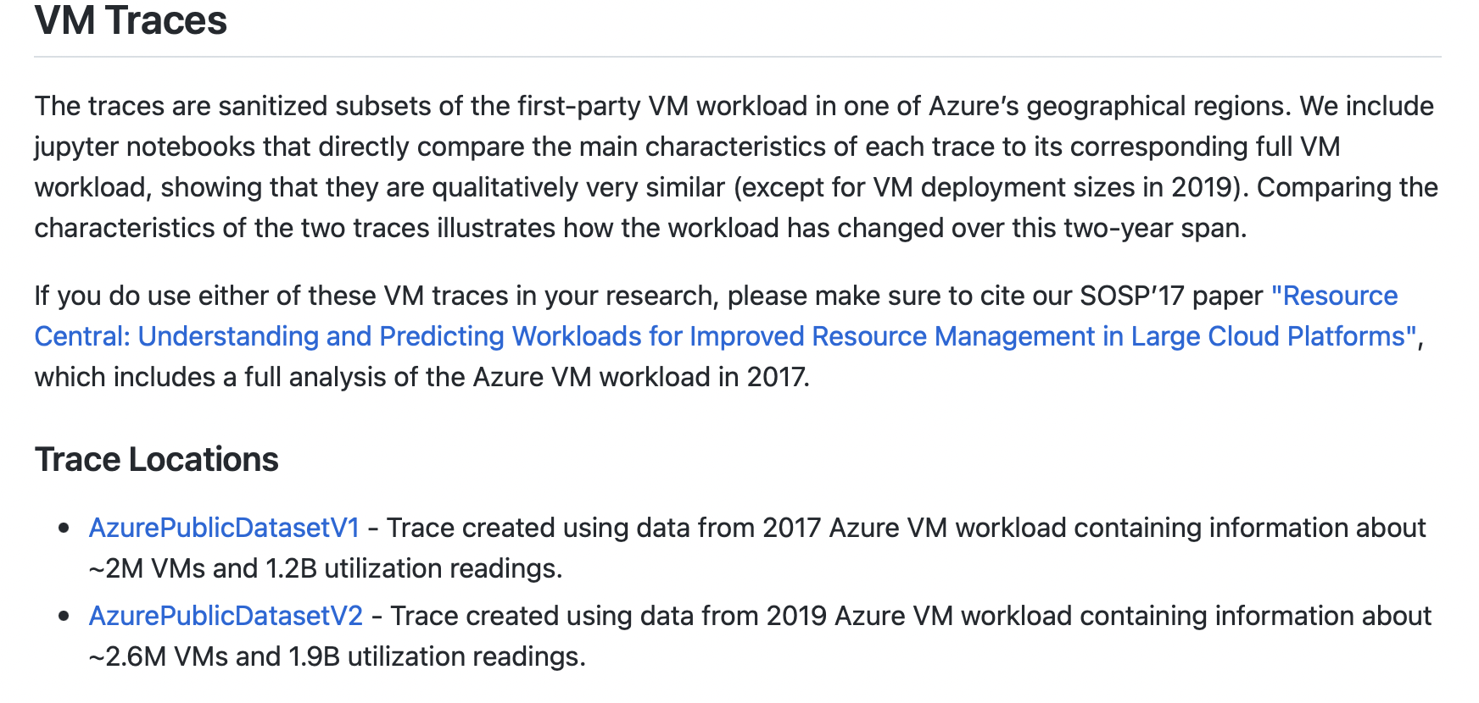
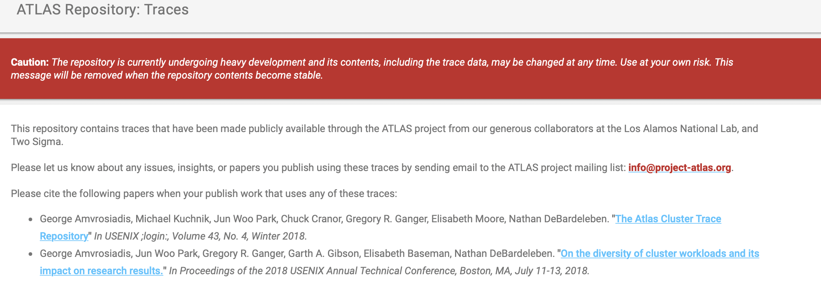
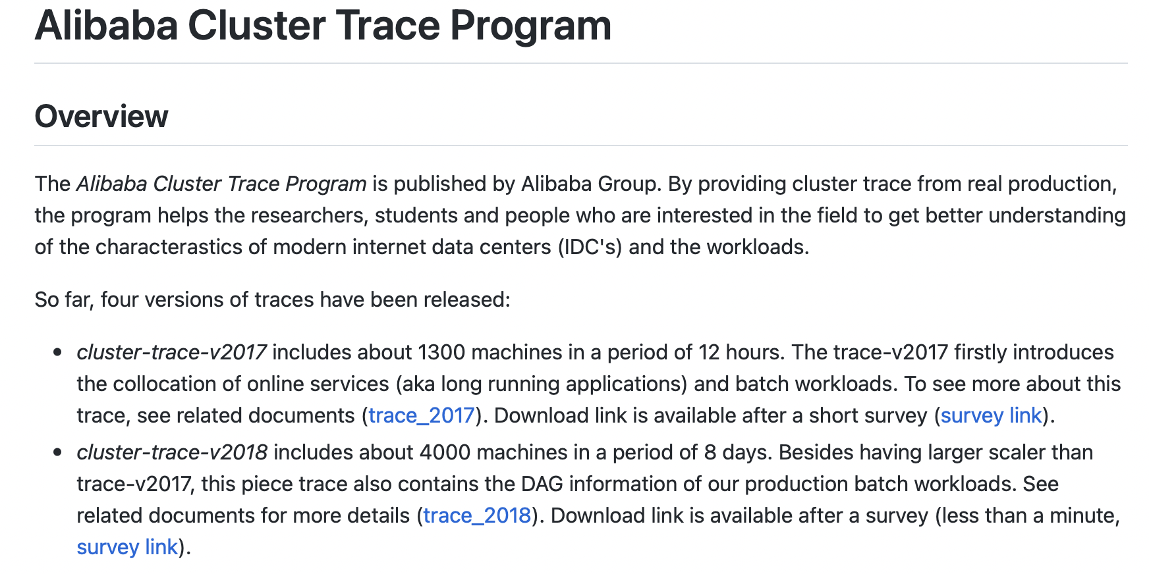
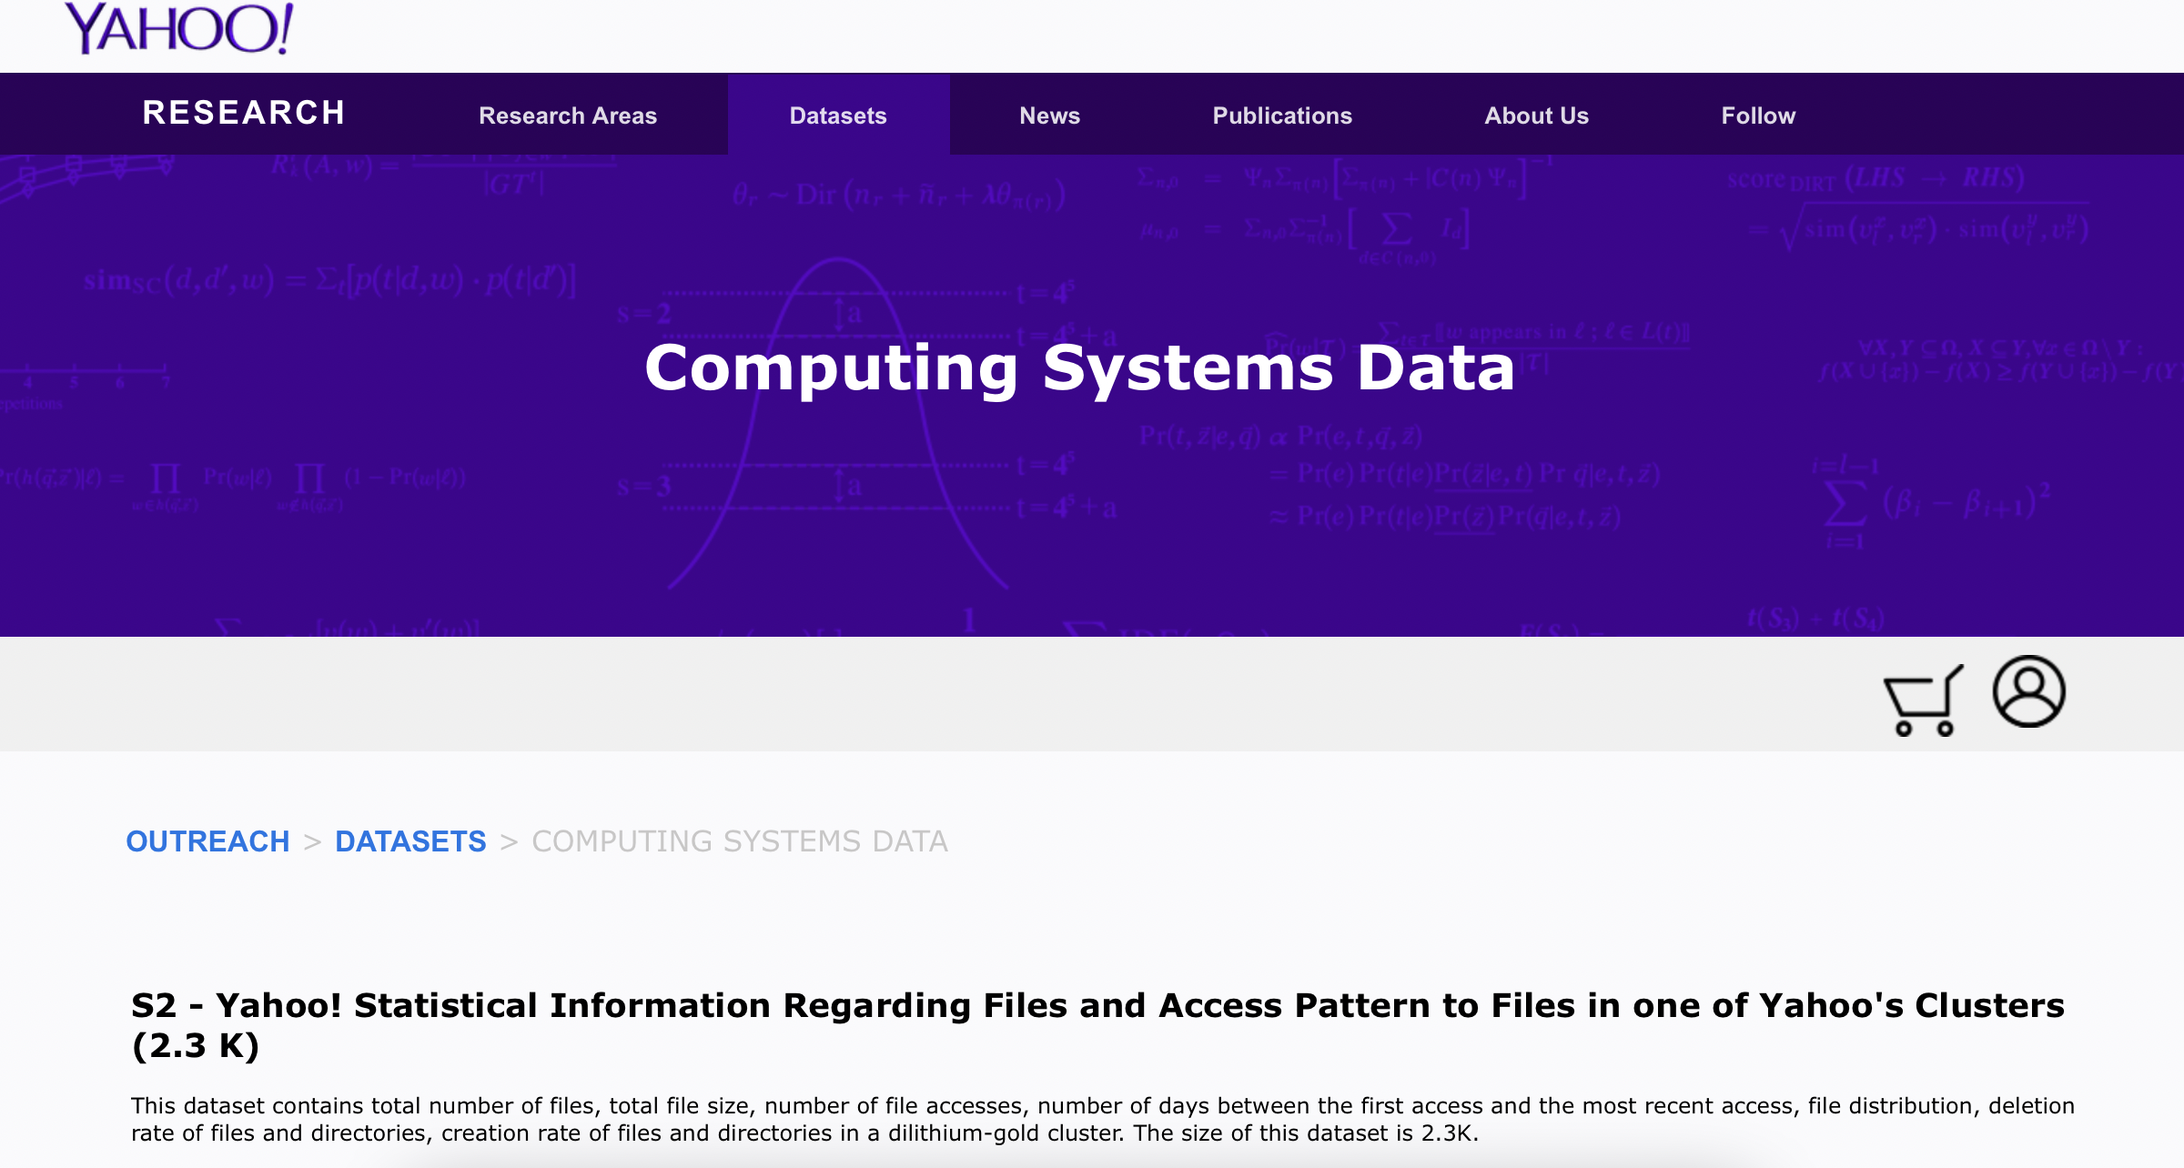
Problem Statement
How can such workloads be simulated on a Kubernetes clusters?
Notes:
Many companies have made available traces of workloads running on their compute clusters. Some examples include workloads from Google Borg, Alibaba Cluster Trace Program, Yahoo Research, Atlas, and many more.
If you are working on any aspect of cluster infrastructure and management, like I am, then it is highly likely you will need these workloads to benchmark your design. . This talk is intended for people who would like to use public cluster data on their Kubernetes cluster.
Why Kubernetes – Kubernetes is a state-of-the-art container orchestration platform with simpler and faster deployment for applications. It automates many of the manual processes involved in deploying, managing, and scaling containerized applications. It is completely open-source, and has a large open-source community driving it. Therefore, Kubernetes was my choice for managing my cluster.

Slide 3
Workload Files
Collection of requests.
Each request is described by -
Arrival Time
Number of Tasks
Estimated Task Running Time
Actual Task Running Times []
Notes:
The workloads are a collection of requests, and each request is described by parameters such as the arrival time, number of work items, estimated running time of each of these items, and finally, the actual running times of these items.
For example – this request arrives at 112th second, and consists of one work item. Its estimated running time is 7.64s and the actual running time of this task is 7.64s as well.
The second example is a request that arrives in the 98th second and consists of 2 work items. The estimated running time of a work item is 5.2s, and the actual running time of these items is 3.99 and 6.51s.

Slide 4
Mapping Requests To Kubernetes Jobs
Kubernetes Job = Collection of Pods.
One Request translates to one Kubernetes Job.
Number of Pods in Job = Number of Tasks in Request
Jobs triggered at arrival times.
1:1 Request <-> Job
1:1 Work Item <-> Pod
Notes:
A Kubernetes job object is a collection of one or more pods. This is logically equivalent to a request line in the workload file. So, we translate every request line in the workload file into a job object. The system will end up having as many jobs as there are request lines in the workload file.
A request line specifies the number of work items, as we have seen. We translate items to pods, so every job has as many pods as number of items in the request.
We trigger these jobs at the time of arrival specified in the request.

Slide 5
Overview
Setup
Start a Work Queue (REDIS)
Insert Task Durations from workload file into the Queue
Example - job1[2.345, 3.456, 4.567], job2[...], …
Create image that consumes the list against the request id.
Create Job Template that uses Image.
Identifiers like $JOBID, $NUM_TASKS
Notes:
Start a work queue which holds job-specific information. I have used Redis as my work queue.
For each job, insert Task Durations from workload file into the queue.
Build the docker image of the worker which works with the queue.

Slide 6
Overview
For Each Request -
From Job Template -> Create Individual Job Manifests.
Replace $JOBID, $NUM_TASKS from workload file.
Apply Job Manifest at the Arrival Time of Request.
Each pod picks up one unit of work from the queue.
Example – For job 1, 3 pods do something for durations [2.345, 3.456, 4.567].
Notes:
Start a work queue which holds job-specific information. I have used Redis as my work queue.
For each job, insert Task Durations from workload file into the queue.
Build the docker image of the worker which works with the queue.

Slide 7

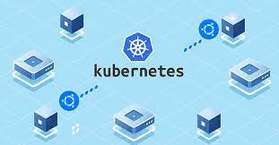

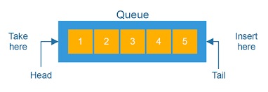


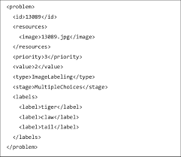
Notes:
Setup
Start a Work Queue (REDIS)
Insert Task Durations from workload file into the Queue
Example - job1[2.345, 3.456, 4.567], job2[...], …
Create image that consumes the list against the request id.
Create Job Template that uses Image.
Identifiers like $JOBID, $NUM_TASKS
For Each Request -
From Job Template -> Create Individual Job Manifests.
Replace $JOBID, $NUM_TASKS from workload file.
Apply Job Manifest at the Arrival Time of Request.
Each pod picks up one unit of work from the queue.
Example – For job 1, 3 pods do something for durations [2.345, 3.456, 4.567].

Slide 8
Solution – A Hybrid Job Pattern
Combination of 3 Job Patterns.
https://kubernetes.io/docs/concepts/workloads/controllers/job/
Notes:
This solution is unique, because it is a combination of 3 job patterns recommended by Kubernetes.
Work Queue - Worker program may or may not be aware of a work queue. We use a pattern which employs a work queue, and the worker program connects to this queue and processes items from the queue.
Processing One Item Per Pod - Typically, worker program may process multiple items per pod when using a work queue. However, we only process one work item per pod. This is because we ensure all items complete successfully, and this is just the number of pods that have successfully completed.
Job Template Pattern - We use a job template to generate jobs.

Slide 9
More Information – Code On Gist
https://gist.github.com/csesmita/db3d1cf0b69f9e8717d801f9b51bdfd2
Includes –
Job Template - yaml
Job Setup, Generation and Processing Script – Python

Slide 10
Thank You!

Slide 11
Other Settings
Kubernetes cluster parameters need to be adjusted –
Set Pod env variables.
Set docker credentials, if using Docker Hub.
Setting Job Backoff Limit.
Configuring GC of Pods
Configuring API Server rate limiting, etc.

